Slide 1
Meeting 7 Gains and Losses: Helping Children Leave Foster Care

Slide 2
Video: Angela

Slide 3
Helping Children Transition from Foster Care
Select a reporter and a recorder
Write one strategy–something the foster parent can say or do–for each message
Be ready to share in 10 minutes

Slide 4
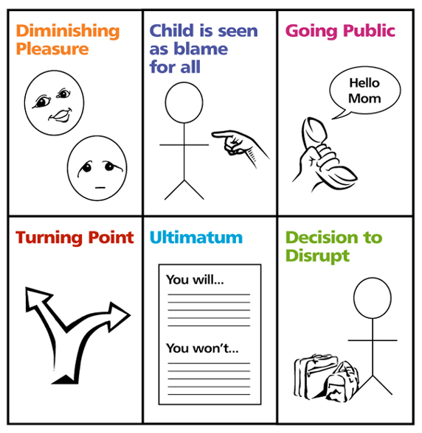
Stages of a Disruption or Dissolution

Slide 5
Planning to Prevent a Disruption
Select a recorder/reporter
Read the case examples
Write preventions and interventions for each case example
Be prepared to share in 5 minutes

Slide 6
Assessing Your Own Families
Select a facilitator
Each person shares at least two ideas
For 3 minutes discuss:
A stressful situation that could lead to a disruption in your home
A strategy to intervene or prevent a possible disruption in your home

Slide 7
Giving Permission: The Steps of Integration

Slide 8
Commemoration
An activity to honor important people in the child’s life
A way of helping a child express grief
Another way for important adults to demonstrate support and permission to love the people who are part of the child’s past, present, and future

Slide 9
Roadwork
Complete your Strengths/ Needs Worksheet
Read Handouts 12 through 17 and discuss them with friends and/or family members
Complete Handout 18

